Slide 1
Breaking NLI Systems with Sentences that Require Simple Lexical Inference
ACL 18
Notes:
Hello everyone. Today I will introduce this paper. It is accepted by ACL 18. It doesn’t propose complicated model or algorithm to improve some metrics. But I think it did a very good job in NLI area by creating a targeted dataset and designing thorough experiments based on the essential analysis of the NLI problem itself.

Slide 2
Roadmap
Introduction
Data Collection
Experiment
Conclusion
Notes:
The presentation consists of 4 parts. In the first part I will introduce the NLI problem and its recent research progress along with the motivation of this paper. Then in the second and the third parts, we will see how they create a new dataset and design the experiments to confirm their hypothesis. Finally, the conclusion.

Slide 3
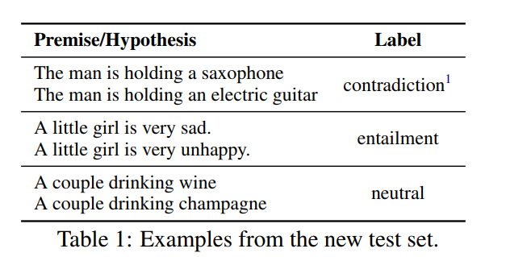
Introduction
Natural Language Inference Tasks (NLI)
Known as Recognizing Textual Entailment(RTE) before 2015.
Identifying whether a premise sentence entails, contradicts or is neutral with the hypothesis sentence.
Notes:
Now I’ve talked about NLI several times but what on earth is the NLI task ? NLI stands for natural language inference, which is known as recognizing textual entailment before 2015. In this task, we need to identify whether a premise sentence entails, contradicts or is neutral with the hypothesis sentence. For example, we have premise ‘the man is holding a saxophone’, and the hypothesis ‘the man is holding an electric guitar’. We say they are contradicted to each other because saxophone and guitar are not the same instrument. Another example, ‘a little girl is very sad’, ‘a little girl is unhappy’. The relation is ‘entailment’ because sad and unhappy convey the same meaning. The last one is a neutral example because wine may or may not be champagne.

Slide 4

Introduction
SNLI
570k sentence pairs.
The premises are captions from an image.
The crowd-sourced workers wrote hypothesis.
Multi-NLI
SciTail
Notes:
In NLI area, we have some large labeled corpus. The most famous one is the SNLI corpus created by Stanford. It contains 570k sentence pairs. The premises are captions from an image that describes the event happened in that image. The crowd-sourced workers were asked to write hypothesis according to some guidelines. Multi-NLI and SciTail are another two large labeled corpus that complement the narrow domain of the SNLI dataset. But they are not the leading roles today so we just skip them.

Slide 5
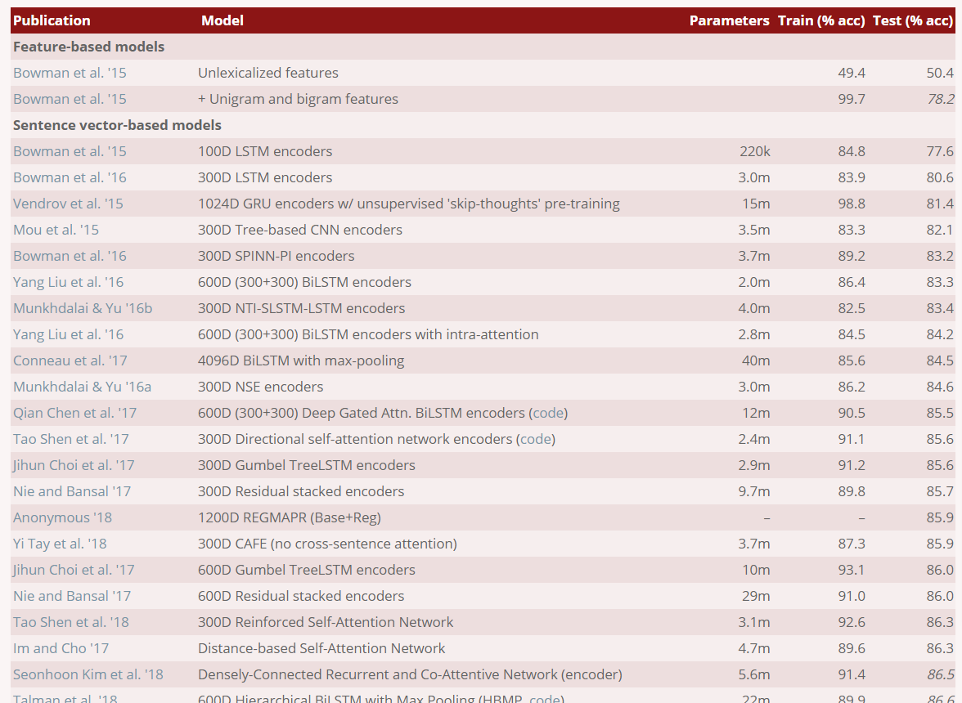

Introduction
Neural Approaches for NLI.
Sentence encoding models
Attention-based models
Notes:
Following the release of SNLI, there has been tremendous interest in the task, and many end-to-end neural models were developed, achieving promising results. There are two main approaches, one is sentence encoding models, which encode the premise and hypothesis individually. The other one is attention-based models. They are not the point today so we won’t go into the details. We just need to know their recent performance. Below is the leaderboard of the SNLI dataset. They can achieve pretty high accuracy when predicting the inference relations between the premise and the hypothesis. One model named ESIM, which achieved 88.6% accuracy on the test set. KIM is the variant of ESIM incorporating external knowledge.

Slide 6
Introduction
External Knowledge
Human do NLI tasks based on their knowledge about the world.
Traditional RTE methods relied on lexical knowledge, e.g. WordNet.
Neural methods relied solely on pre-trained word embeddings.
The only neural model incorporating external lexical knowledge, i.e. KIM, gained only an addition of 0.5 points in accuracy on the SNLI test set.
Notes:
Now let’s think about the NLI task itself. When a human is asked to do this task, he or she will do it based on the knowledge about the world. For example, saxophone and guitar are different instruments. Unhappy and sad convey the same meaning, etc. In fact, traditional RTE methods relied on lexical knowledge, like WordNet. Neural methods relied solely on pre-trained word embeddings but they achieve good results. However, when they incorporate external knowledge, they gained only an addition of 0.5 points in accuracy on the SNLI test set. It seems that external knowledge won’t help the NLI task, which contradicts to our intuition.

Slide 7

Introduction
QUIZ : What might be the reason for the negligible performance gain when incorporating external knowledge into neural methods ?
Neural methods are so strong that obviate the need of external knowledge.
Large-scale training data allows for implicit learning of external knowledge.
The NLI datasets are simpler than early RTE datasets, requiring less knowledge.
The model not capturing external knowledge well.
Notes:
Here is the quiz.

Slide 8

Introduction
QUIZ : What might be the reason for the negligible performance gain when incorporating external knowledge into neural methods ?
Neural methods are so strong that obviate the need of external knowledge.
Large-scale training data allows for implicit learning of external knowledge.
The NLI datasets are simpler than early RTE datasets, requiring less knowledge.
The model not capturing external knowledge well.
Notes:
The answer is all above.
In particular, option A and option D try to find out the reason from the model, while option B and option C think about the dataset.
In the rest of the paper, the author will create a targeted dataset and design thorough experiments to verify these hypothesis.

Slide 9
Data Collection
Construct a test set to evaluate SOTA NLI models’ ability to make inferences that require simple lexical knowledge.
😀 Do it well -> learned something
😧 Do it bad -> achieved high score by tricks
Replace a single word within the premise by a different word
Allow some multi-word noun phrases, e.g., ‘electric guitar’
Entailment: replaced by its synonym or hypernym
Contradiction: replaced by its antonym or co-hypernym
Neutral: skip ! Leave it as a by-product.
Notes:
Firstly, let’s see how the author create the targeted dataset, or we can say, the adversarial dataset. The goal of creating such dataset is to evaluate the SOTA NLI models’ ability to make inferences that require simple lexical knowledge. If the SOTA models do it well, it means the models have learned something. Otherwise, we suspect that the models achieved the high accuracy by some tricks.
The creating method is quite simple but not trivial. We just replace a single word within the premise by a different word. Note that we allow some multi-word noun phrases, for example, electric guitar. For entailment, we replace the word by its synonym or hypernym. For contradiction, we replace the word by its antonym or co-hypernym, like electric guitar and saxophone.
We skip the neutral sentences and leave it as a by-product when creating entailment or contradiction data.

Slide 10
Data Collection
Manually Verification
The newly introduced words are all present in the training set.
Do the sentences describe the same event ?
✔️ -> entailment ❌ -> contradiction
Does the hypothesis add new information to the premise ?
✔️ -> neutral (✔️) ❌-> entailment
Is the new sentence incorrect / ungrammatical ?
Discard !
Notes:
The author ask crowd-source workers to manually verify the adversarial dataset. They will ensure that the newly introduced words are all present in the training set. This constraint will evaluate the model’s inference ability for known words. Then the workers need to answer the following three question.
Do the sentences describe the same event ? If the answer is negative, then it will be labeled as contradiction. If the answer is positive, and, the answer for the second question, does the hypothesis add new information to the premise, is negative, then we label it as entailment. If the answer for the second question is positive, we label it as neutral.
Finally if the sentence is incorrect or ungrammatical, we discard it.

Slide 11
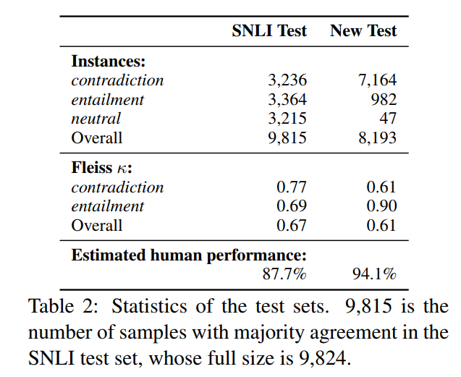
Data Collection
Statistic of the test sets
Notes:
Here is the statistic of the test sets. We can see that the new test sets have a obvious bias towards contradiction. So the author suggests use it in addition to the original test set instead of training nor evaluating. The Fleiss k is a statistical metric in the range of 0 to 1. The larger it is, the more agreement between the annotators, i.e., the crowd workers.
And we can see that the estimated human performance of the new test sets is much higher than the original one, which means the new test set is simpler for human.

Slide 12
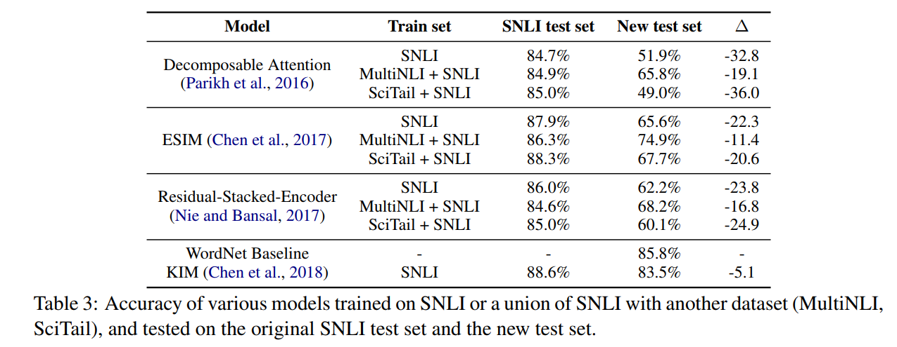
Experiment
Notes:
Now, how the SOTA models perform on the new simpler datasets ? The author selected 4 SOTA models. All of these models are based on pre-trained GloVe embeddings. But these two guys will fine-tune the word embedding and this one will stay fixed.

Slide 13
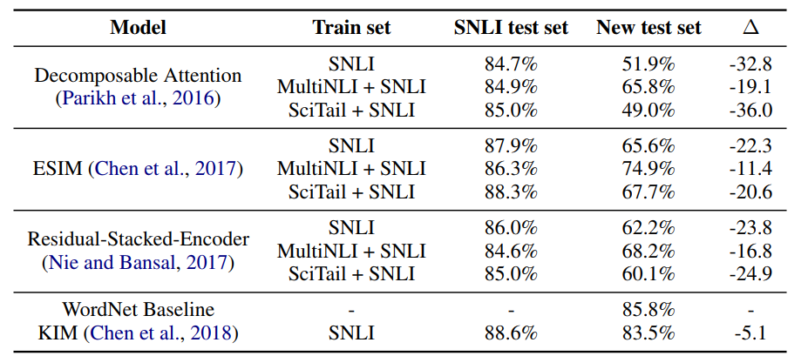
Experiment
Embedding Stay fixed
Embedding
Fine-tuned
Notes:
Now, how the SOTA models perform on the new simpler datasets ? All of these models are based on pre-trained GloVe embeddings. But these two guys will fine-tune the word embedding and this one will stay fixed.

Slide 14
Experiment
Neural method without external knowledge
Neural method incorporating external knowledge
Notes:
Now, how the SOTA models perform on the new simpler datasets ? All of these models are based on pre-trained GloVe embeddings. But these two guys will fine-tune the word embedding and this one will stay fixed.

Slide 15
Experiment
Predict according to the relation between the two distinct words in the WordNet.
Notes:
Now, how the SOTA models perform on the new simpler datasets ? All of these models are based on pre-trained GloVe embeddings. But these two guys will fine-tune the word embedding and this one will stay fixed.

Slide 16
Experiment
Lexical knowledge is the only requirement for good performance on the new test set.
Notes:
Despite the task being considerably simpler, the drop in performance is substantial. The accuracy drop from 20 to 30 points for those vanilla neural models. KIM outperformed them by only dropping 5.1 points, demonstrating that the lexical knowledge is the only requirement for good performance on the new test set.

Slide 17
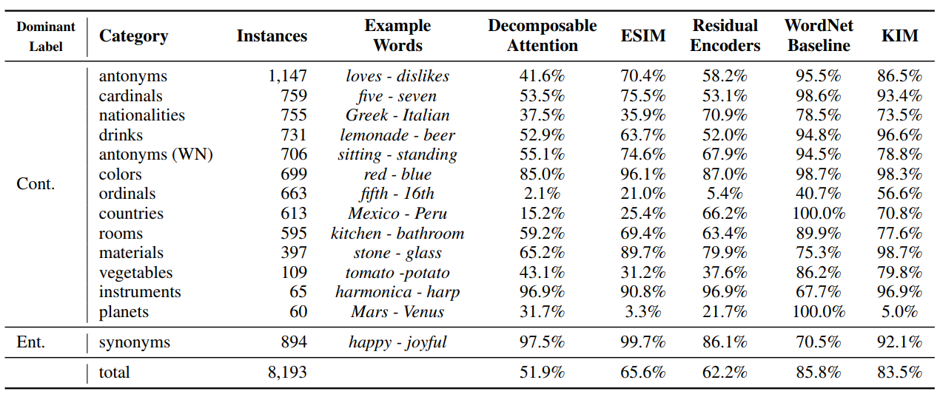
Experiment
Accuracy by Category
Notes:
Now let’s look into the predictions of the models that don’t employ external knowledge. In this table. Category means the category between the original word and the replaced word. Instances is the number of the specific category. Examples here, like, lemonade and beer, are all drinks. The neural

Slide 18
Experiment
Accuracy by Category
Notes:
Now let’s look into the predictions of the models that don’t employ external knowledge. In this table. Category means the category between the original word and the replaced word. Instances is the number of the specific category. Examples here, like, lemonade and beer, are all drinks. The neural model tend to perform well on categories which are frequent in the training set, such as colors, and badly on categories such as planets, which rarely occur in SNLI. The model perform better than the WordNet baseline on entailment examples, suggesting that they do so due to the high lexical overlap between the two sentences, rather than recognizing synonym.

Slide 19
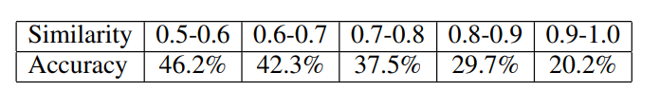
Experiment
Accuracy by Word Similarity
The proximity of the contradicting words in the embedding space.
Notes:
The accuracy for ordinals, nationalities and countries are especially low. The author conjectured that this stems from the proximity of the contradicting words in the embedding space. The decomposable Attention, which doesn’t update its embedding during training, seems suffer the most. The author grouped the prediction accuracy by the cosine similarity between the contradicting words, and they obtained a clear trend that the model errs more on contradicting pairs with similar pre-trained vectors.

Slide 20
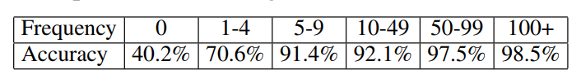
Experiment
Accuracy by Frequency in Training
Models that fine-tune the word embeddings may benefit from training examples consisting of test replacement pairs.
Many training example contains the original word and the replaced word in the premise and hypothesis respectively.
Notes:
Models that fine-tune the word embeddings may benefit from training examples consisting of test replacement pairs. Namely, if many training examples that is labeled as contradiction contain the original word and the replaced word, the model my update their embeddings to optimize predicting contradiction. The author showed that the ESIM accuracy on test pairs increases with the frequency in which the replacement words appear in the contradiction training data.
This demonstrates that when sufficient data is given, the model is capable of learning lexical knowledge.

Slide 21

Conclusion
What might be the reason for the negligible performance gain when incorporating external knowledge into neural methods ?
Neural methods are so strong that obviate the need of external knowledge.
Large-scale training data allows for implicit learning of external knowledge.
YES. But under the condition that we have sufficient data.
Relying solely on the large amount of data seems inefficient.
The SOTA models on SNLI are limited in their generalization ability.
Can BERT do well on the BNLI dataset ?
Notes:
Now let’s try to answer the question we raised in the introduction part.
There is an open question. As we know, BERT is a pre-trained model that is trained on a very very large amount of corpus, can it do well on the BNLI dataset ?

Slide 22
Conclusion
What might be the reason for the negligible performance gain when incorporating external knowledge into neural methods ?
The NLI datasets are simpler than early RTE datasets, requiring less knowledge.
NO.
The BNLI is much simpler but the neural models without external knowledge perform badly on it.
The models do well on the SNLI dataset partially because the bias of the SNLI dataset, i.e. artifacts.
Notes:
Now let’s try to answer the question we raised in the introduction part.

Slide 23
Conclusion
What might be the reason for the negligible performance gain when incorporating external knowledge into neural methods ?
The model not capturing external knowledge well.
NO.
KIM did good job on the BNLI dataset but still needs improvement.
Notes:
Now let’s try to answer the question we raised in the introduction part.

Slide 24
Conclusion
The author pointed out the limitation of the NLI models.
Provide an adversarial dataset for further improvement.
Some thoughts
From motivation, hypothesis and experiment confirmation, the flow of the paper is very neat and the results are convincing.
The research style is worth learning.
Notes:
To sum up, the author pointed out the limitation of the NLI models, and provide an adversarial dataset for future improvement. I think it is a good paper because from motivation, hypothesis and experiment confirmation, the flow of the paper is very neat and the results are convincing. I think the research style is worth learning.

